Slide 1
SQL (IMDB - Movies)
Ritik Das

Slide 2
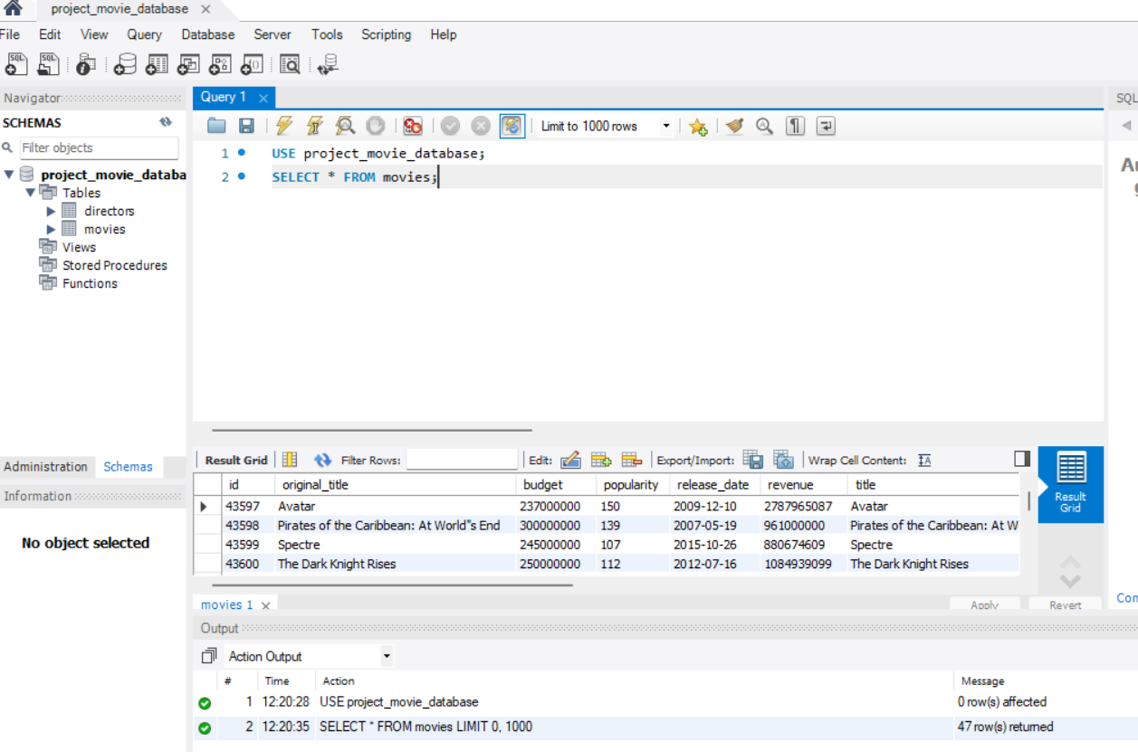
First We should write Use Database statement.
If We Want to fetch and view the movies table write Select * FROM movies; all the data will be fetched and you can see the content of the table .
From The SS attached u can see the movies table has id of the movies , title of the movie , the movie budget , popularity release date so these are the columns of the table rows contains each movies list .

Slide 3
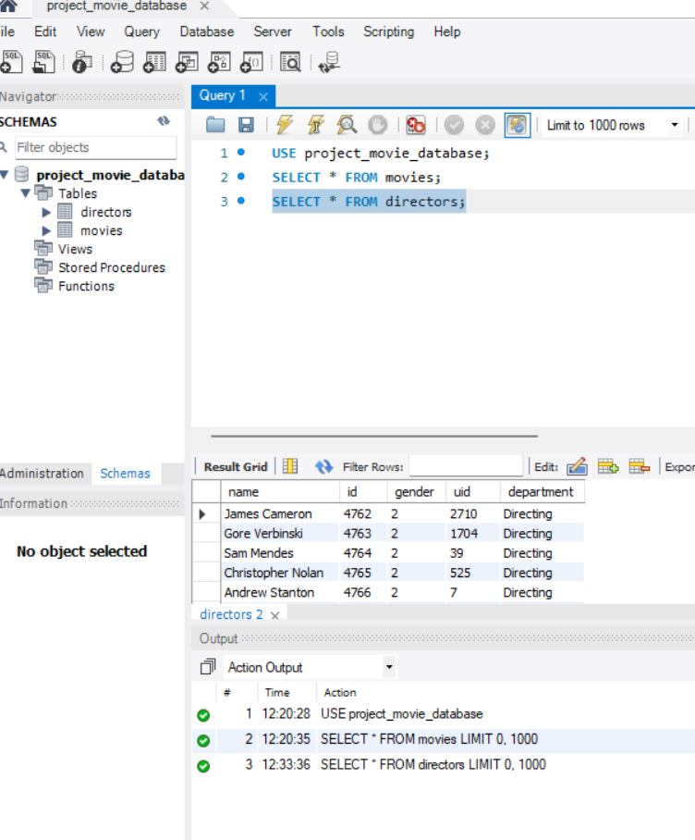
If you want to see the Director’s table then write , SELECT * FROM directors; .
The Director’s table will be fetched and the columns the Director’s table has is Name of the Director, id ,Gender , UID and Department of the Director.

Slide 4
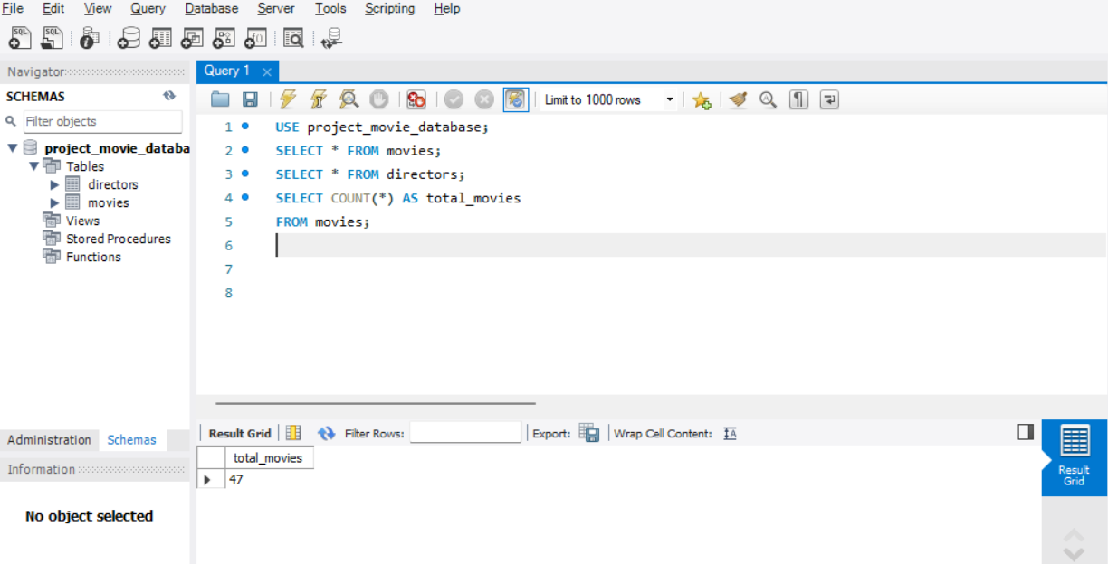
IF we want to see how many movies are present then write SELECT COUNT (*) AS total _movies FROM movies; .
There are 47 movies altogether.

Slide 5
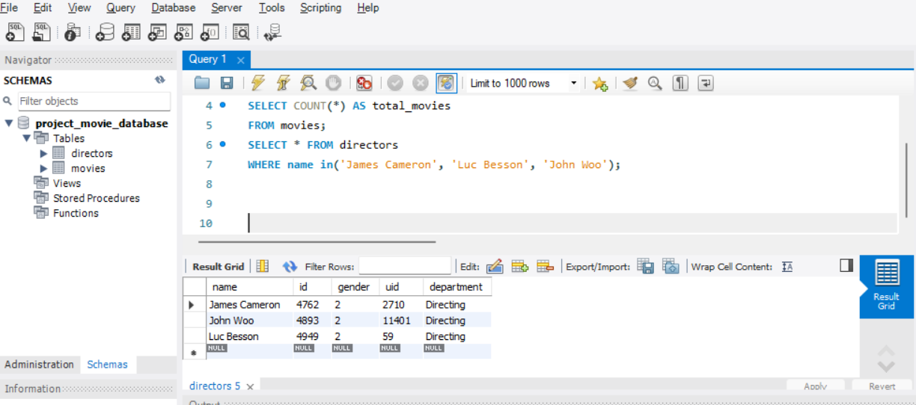
.By writing
SELECT * FROM directors WHERE name in(write the name of the director u want);

Slide 6
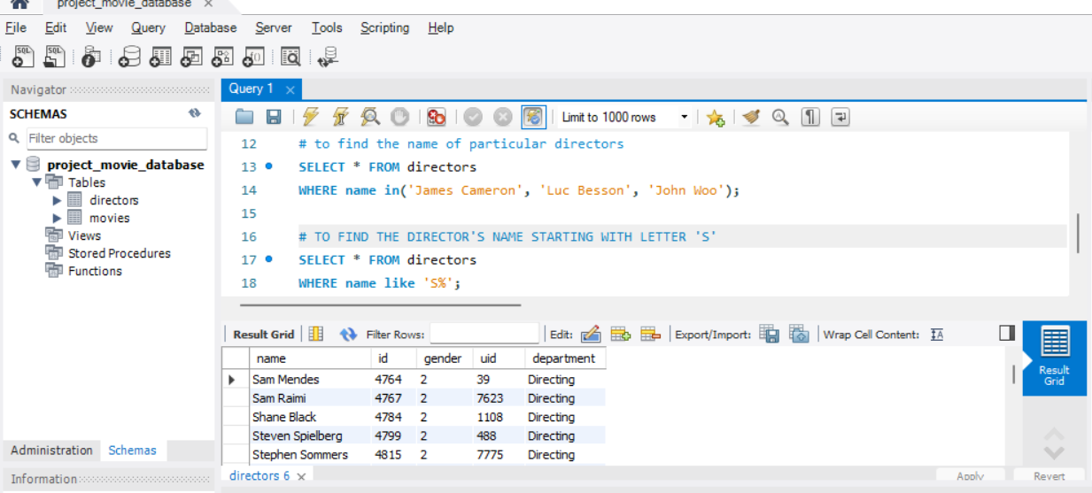
To Find The Director’s name Starting With Letter ‘S’
Write Query SELECT * FROM directors WHERE name like ‘s%’.

Slide 7
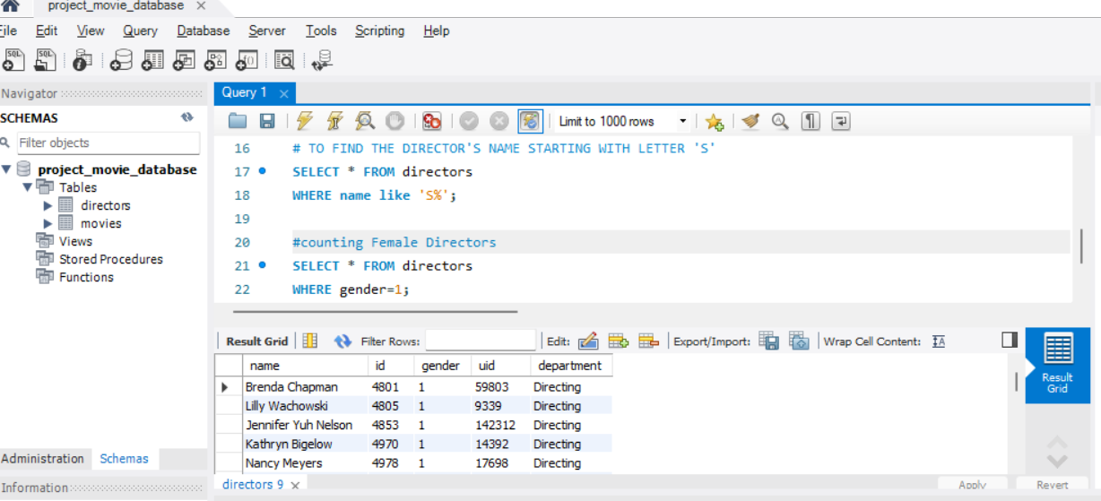
TO see only Female Directors
SELECT * FROM directors WHERE gender=1

Slide 8
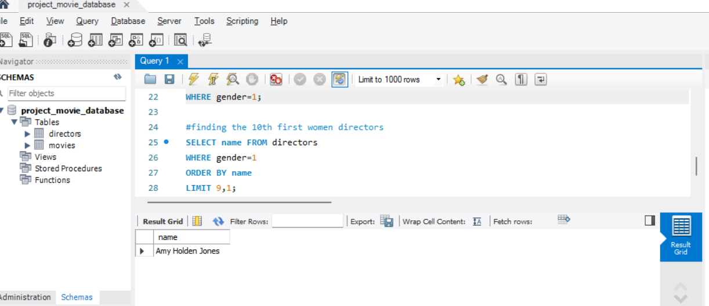
Finding the 10th first women directors
SELECT name FROM directors WHERE gender=1 ORDER BY name LIMIT 9,1;

Slide 9
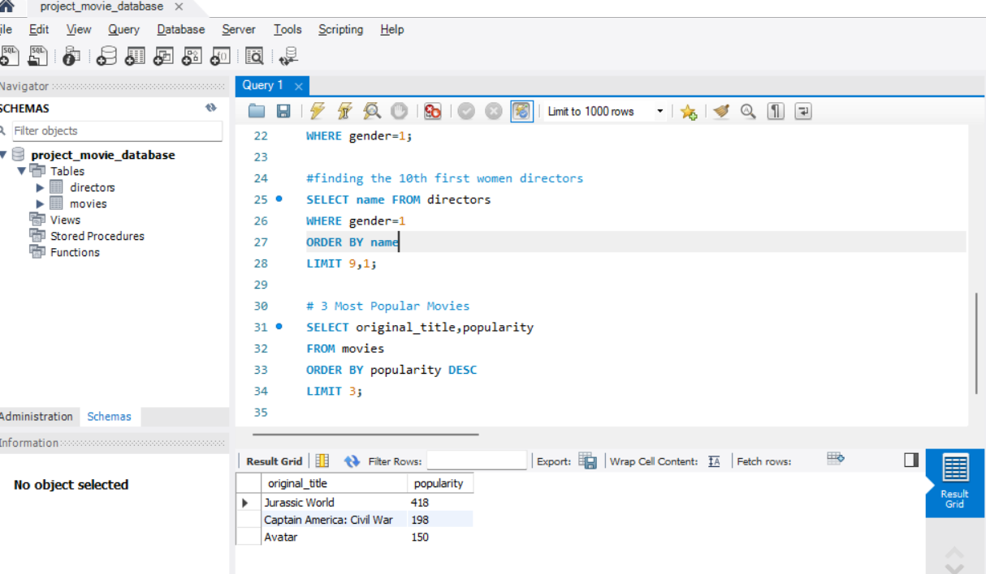
TO FIND TOP 3 POPULAR MOVIES
SELECT original _title, popularity FROM movies ORDER BY Popularity DESC LIMIT 3;

Slide 10
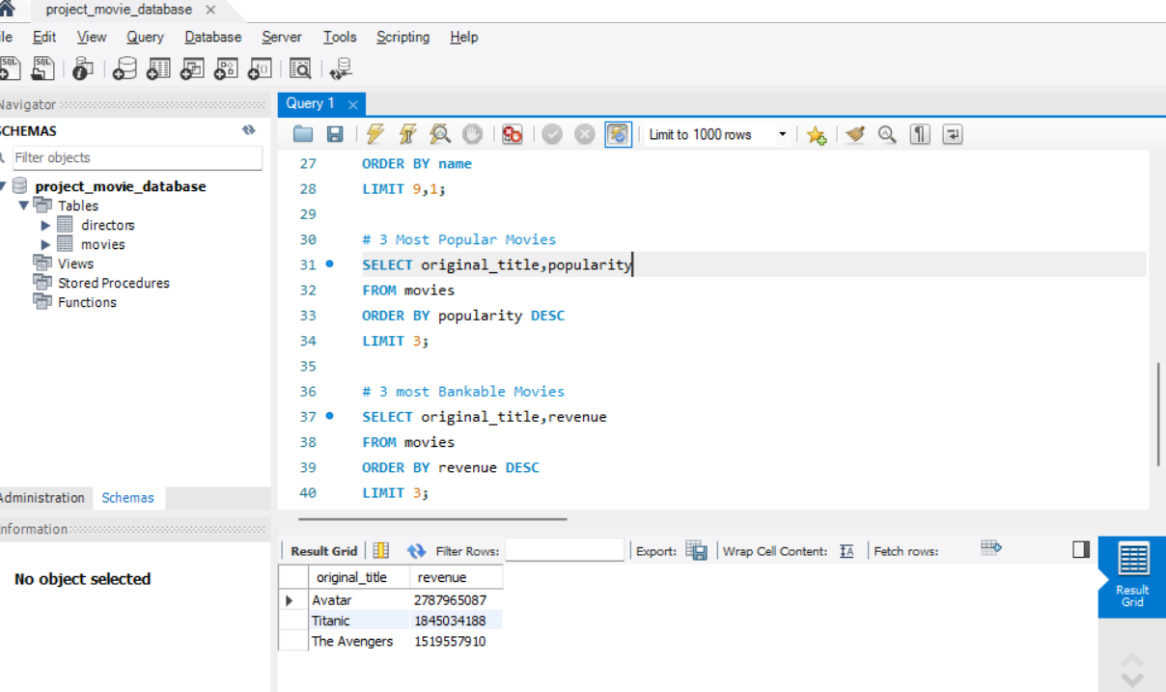
3 MOST Bankable Movies
SELECT original _title, revenue FROM movies ORDER BY revenue DESC LIMIT 3 ;

Slide 11
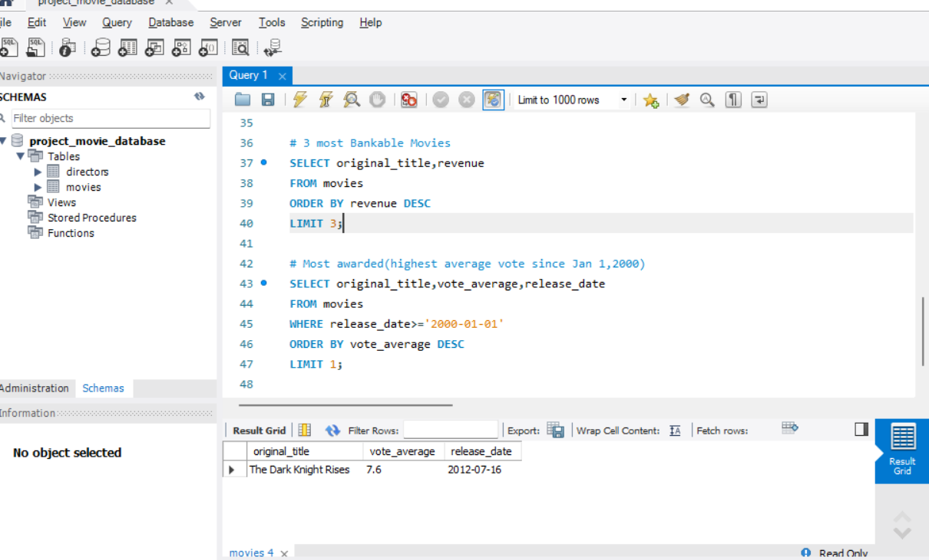
Most awarded highest average vote since Jan 1,2000
SELECT original _ title, vote_ average, release_ date FROM movies WHERE release _date>=‘2001-01-01’ ORDER BY vote _ average DESC LIMIT 3;

Slide 12
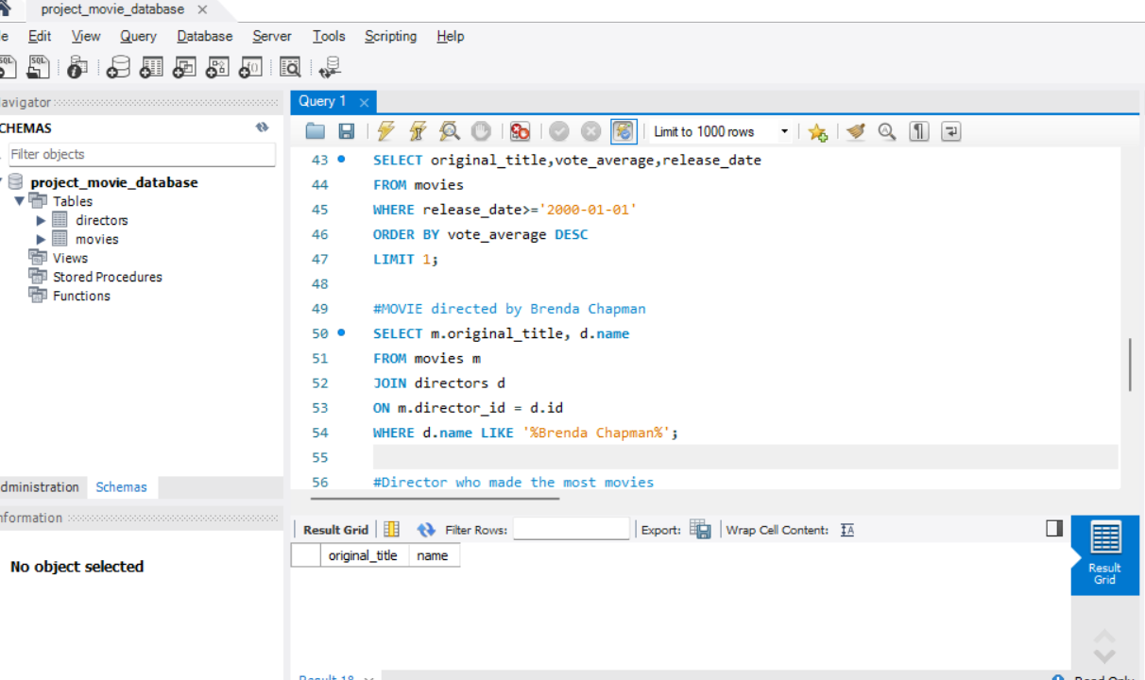
AS there are no records found of director Chapman so record is blank

Slide 13
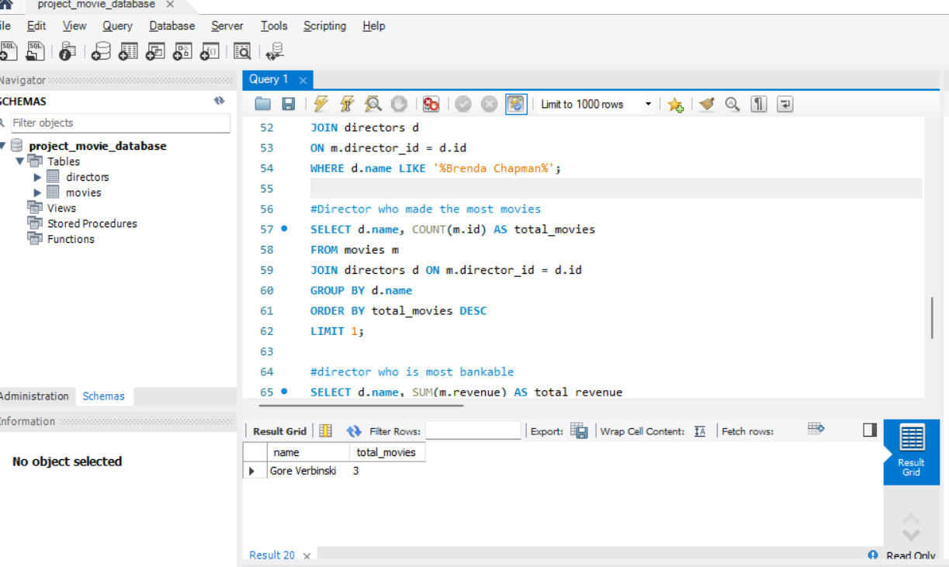
Director who made the most movies
SELECT d.name, COUNT(m.id) AS total_movies
FROM movies m
JOIN directors d ON m.director_id = d.id
GROUP BY d.name
ORDER BY total_movies DESC
LIMIT 1;

Slide 14
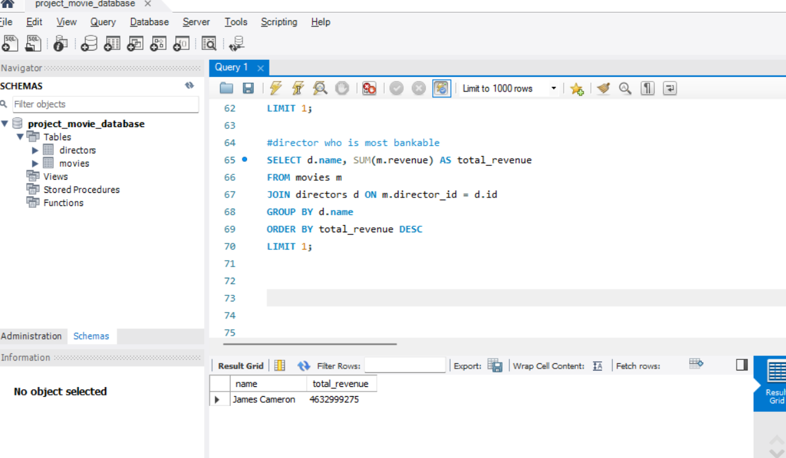
Director who is most bankable
SELECT d.name ,SUM( m. revenue) As total _ revenue FROM movies m JOIN directors d ON m . director d ON m . director_ id = d.id
GROUPBY by d.name
ORDER BY total revenue DESC

